Slide 1
BIRCH Clustering

Slide 2
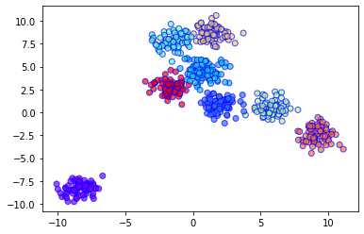
What is BIRCH?
BIRCH is a clustering algorithm for BIG DATA.
It works by making a small, smart summary of the data.
Then it clusters the summary instead of all the data!

Slide 3
Why Use BIRCH?
Handles huge datasets easily. Uses less memory — doesn’t store all the data at once. Can help other algorithms by making data smaller first. Finds outliers too!

Slide 4
How BIRCH Works
Make a CF Tree (Clustering Feature Tree) to summarize the data.
New points are added to the tree step by step.
If adding a point makes a cluster too big, it splits into smaller clusters.
Once the tree is ready, BIRCH can do final clustering on the summary.

Slide 5
What is a CF?
CF = Clustering Feature
It’s a tiny summary of a group of points.
Each CF has:
N → number of points
LS → sum of the points (Linear Sum)
SS → sum of squared points (Squared Sum)
CFs help keep the tree small and efficient.

Slide 6
CF Tree
The CF Tree has nodes.
Each node holds CFs.
Leaf nodes = final small clusters.
If too full → node splits to keep the tree balanced.

Slide 7
Main BIRCH Settings
threshold → how big a cluster can get before splitting.
branching_factor → how many CFs can be in each tree node.
n_clusters → how many final clusters to get at the end (can skip this if you just want the subclusters).

Slide 8
BIRCH vs. Others
Feature | BIRCH | K-Means | DBSCAN
Big Data | ✅ Very Good | ❌ Slower | ✅ Good
Data Reduction | ✅ Yes | ❌ No | ❌ No
Memory Use | ✅ Efficient | ❌ Needs full data | ❌ Needs full data
Outlier Handling | ✅ Yes | ❌ No | ✅ Yes
High Dimensions | ⚠️ Not great | ✅ Better | ✅ Better

Slide 9
When to Use BIRCH
Use BIRCH for big data with lots of samples.
Good when you want to shrink data before final clustering.
Useful for outlier removal.
Not good for very high-dimensional data (too many features).

Slide 10
Extra Tips
BIRCH
BIRCH only works with numeric data (Euclidean distance).
Run
You can run BIRCH in parts using partial_fit for online learning.
Feed
BIRCH can feed other clusterers like K-Means or DBSCAN.

Slide 11
Thankyou

